Slide 1
Energy Management System (EMS) for Storage Cells in Electric Vehicles (EVs)
By: Andrew Tran, Hiromi Saito, & Jonathan Austin
May 14, 2021
Notes:
[J] :
_

Slide 2



The Team
Andrew Tran
Power Module Design
Hiromi Saito
Power Module Design
Jonathan Austin
Embedded Systems
Notes:
[E] :
_

Slide 3
Presentation
Outline
Background
Project Overview
Current Hardware System
Goals
Power Module Design (PMD)
Current Sense Schematic
Printed Circuit Board (PCB)
Simulation Results
Embedded Systems (ES)
DSP PWM Signals
Adapted Sorting Algorithm
PWM Output Results
Work Schedule
Questions
Notes:
[H] : (1min)
_

Slide 4
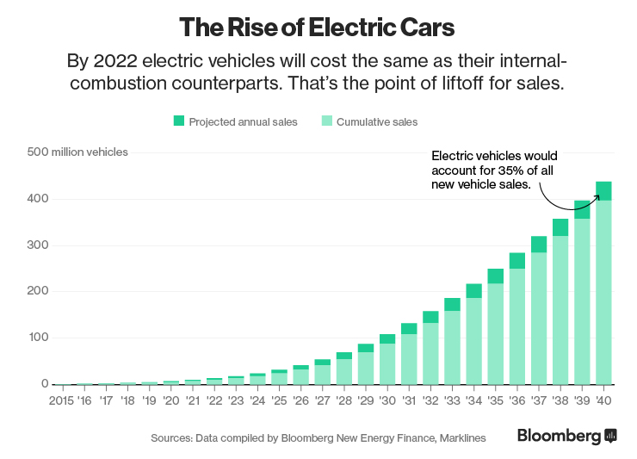
I. Background
In 2035, predicated EV market share of the car industry is roughly 35%
Maintenance of EVs require large improvement
Solution: Novel EMS of Storage Cells
[2]
Notes:
[H] :
Current standards for EVs include separate inverter and battery system which results in more expensive manufacturing and maintenance costs
As EV ownership increases, manufacturing and maintenance for EVs will increase as well.
Combining the inverter and battery system to be modular will improve costs for manufacturing and require less training for maintenance

Slide 5
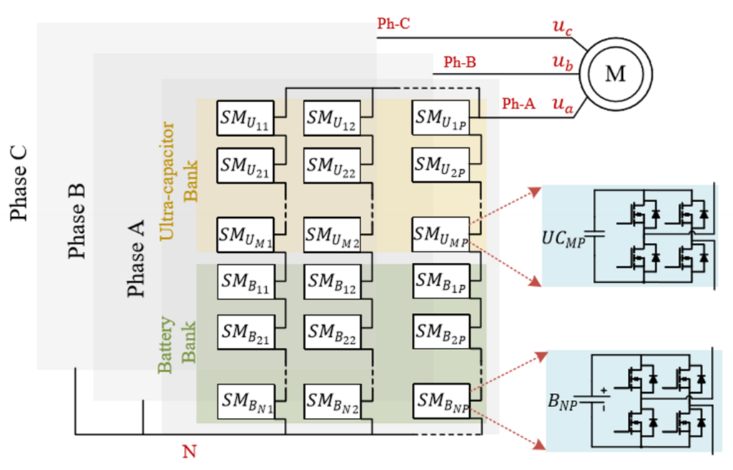
II. Project Overview
[1]
Notes:
[H] : (2min)
_

Slide 6
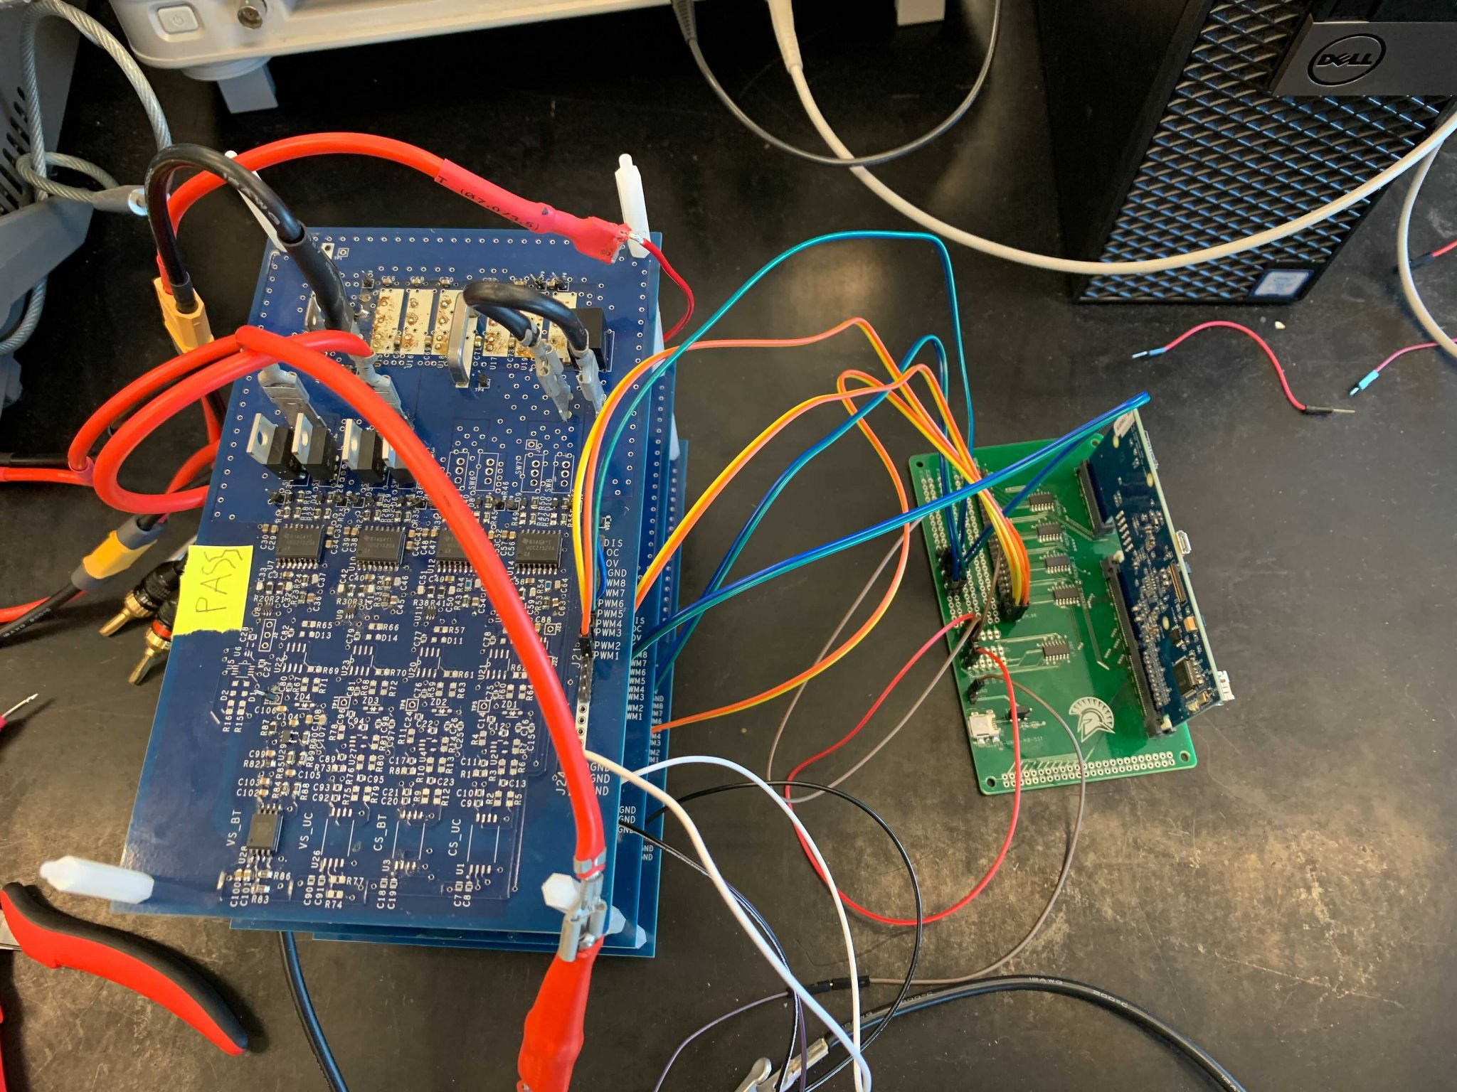
A. Current Hardware System
3 Multilevel Converter (MMC) Boards
Inverter
Old Current Sense
Old Voltage Sensor
Digital Signal Processor (DSP) Controller
Notes:
[A] : MMC
Contains old design of current sense
Designed a new current sense module
Designed a new voltage sensor module
Added LDO
[J] : DSP
_

Slide 7

III. Goals
PMD
Finish PCBs for the redesigned schematics
Testing the new boards
ES
Finish Implementing and Testing SOC Sorting Algorithm
Write SOC Estimation Algorithm
Notes:
[A] : PMD
Again, possibly reiterate what’s being redesigned (current sense and voltage sense modules) and added (LDO)
[J] : ES
_

Slide 8
IV. Power Module Design
Notes:
[J] : (4mins)
_

Slide 9
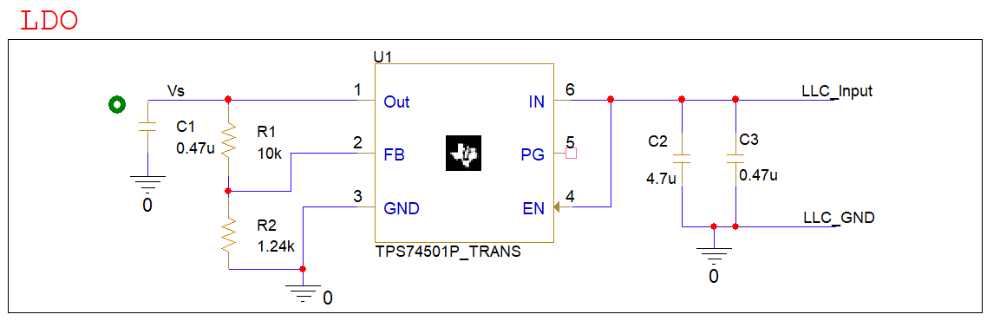
A. Current Sense Schematic (Pt. 1)
Notes:
[A] :
_

Slide 10
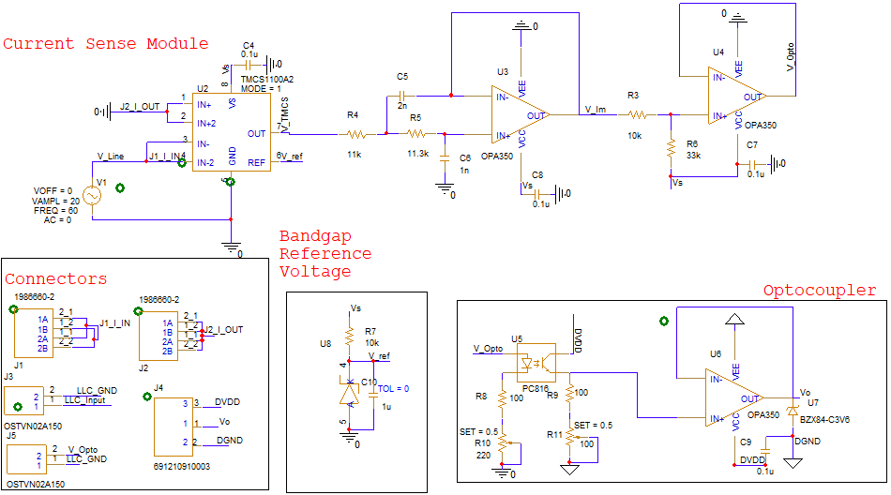
A. Current Sense Schematic (Pt. 2)
Notes:
[A] :
_

Slide 11
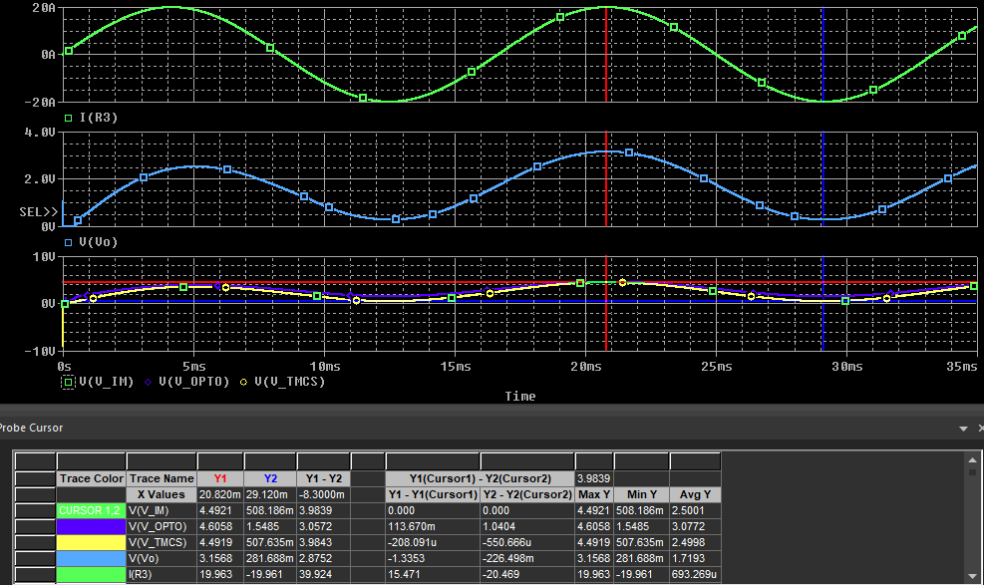
B. Simulation Results
Notes:
[A] : (6.5mins)
_

Slide 12
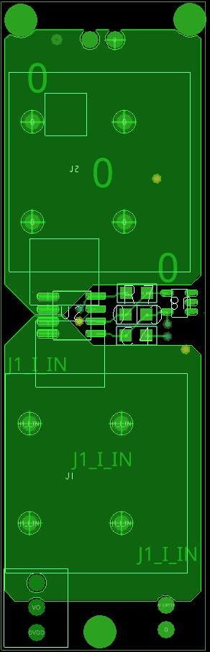
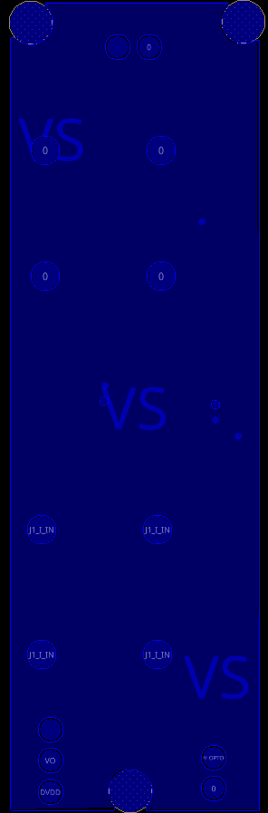
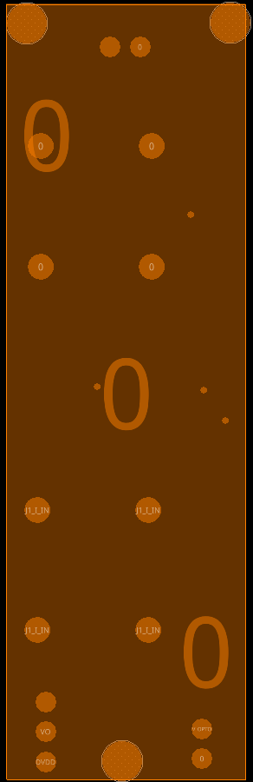
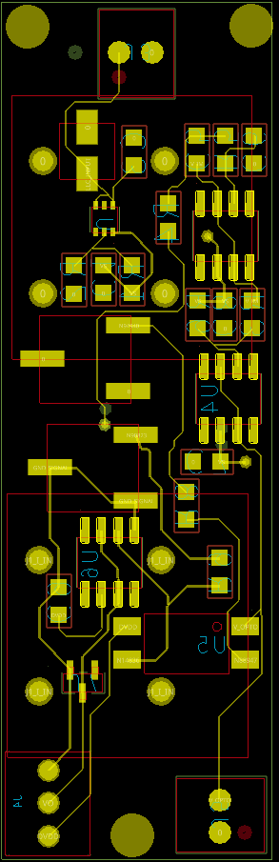
A. Current Sense Schematic (Pt. 1)
Top Layer
Power Layer
Ground Layer
Bottom Layer
Notes:
[H] : (9mins)
Current Sense PCB with the goal of maximizing utility of space
Packing components as closely as possible while also keeping in mind PCB design constraints
Design/manufacturing constraints from Bay Area Circuits
High Power/Current PCB Design constraints
High Current requires polygon pours
4 Layer Board
Current Sense and Band gap reference voltage on top
Rest of Current Sense and block schematics on the bottom
Multiple iterations to reach this compact design
Most difficult part was designing with through hole connectors
Learned a lot about component searching, creating footprints, and working with PCB Editor with Capture
End Result: Current Sense Board that’s the size of a thumb drive that can measure up to 20A

Slide 13
Embedded Systems
Notes:
[H] :
_

Slide 14
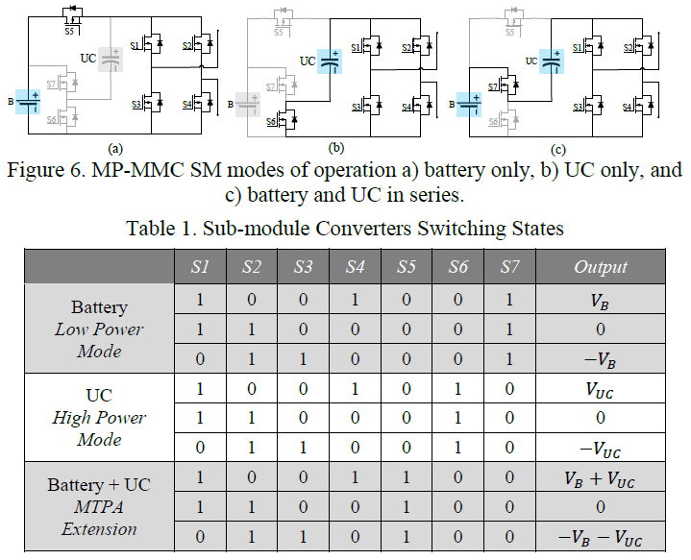
A. Digital Signal Processor (DSP) Pulse Width Modulated (PWM) Signals
[1]
Notes:
[J] :
_

Slide 15
A. Digital Signal Processor (DSP) Pulse Width Modulated (PWM) Signals
[1]
Notes:
[J] :
_

Slide 16
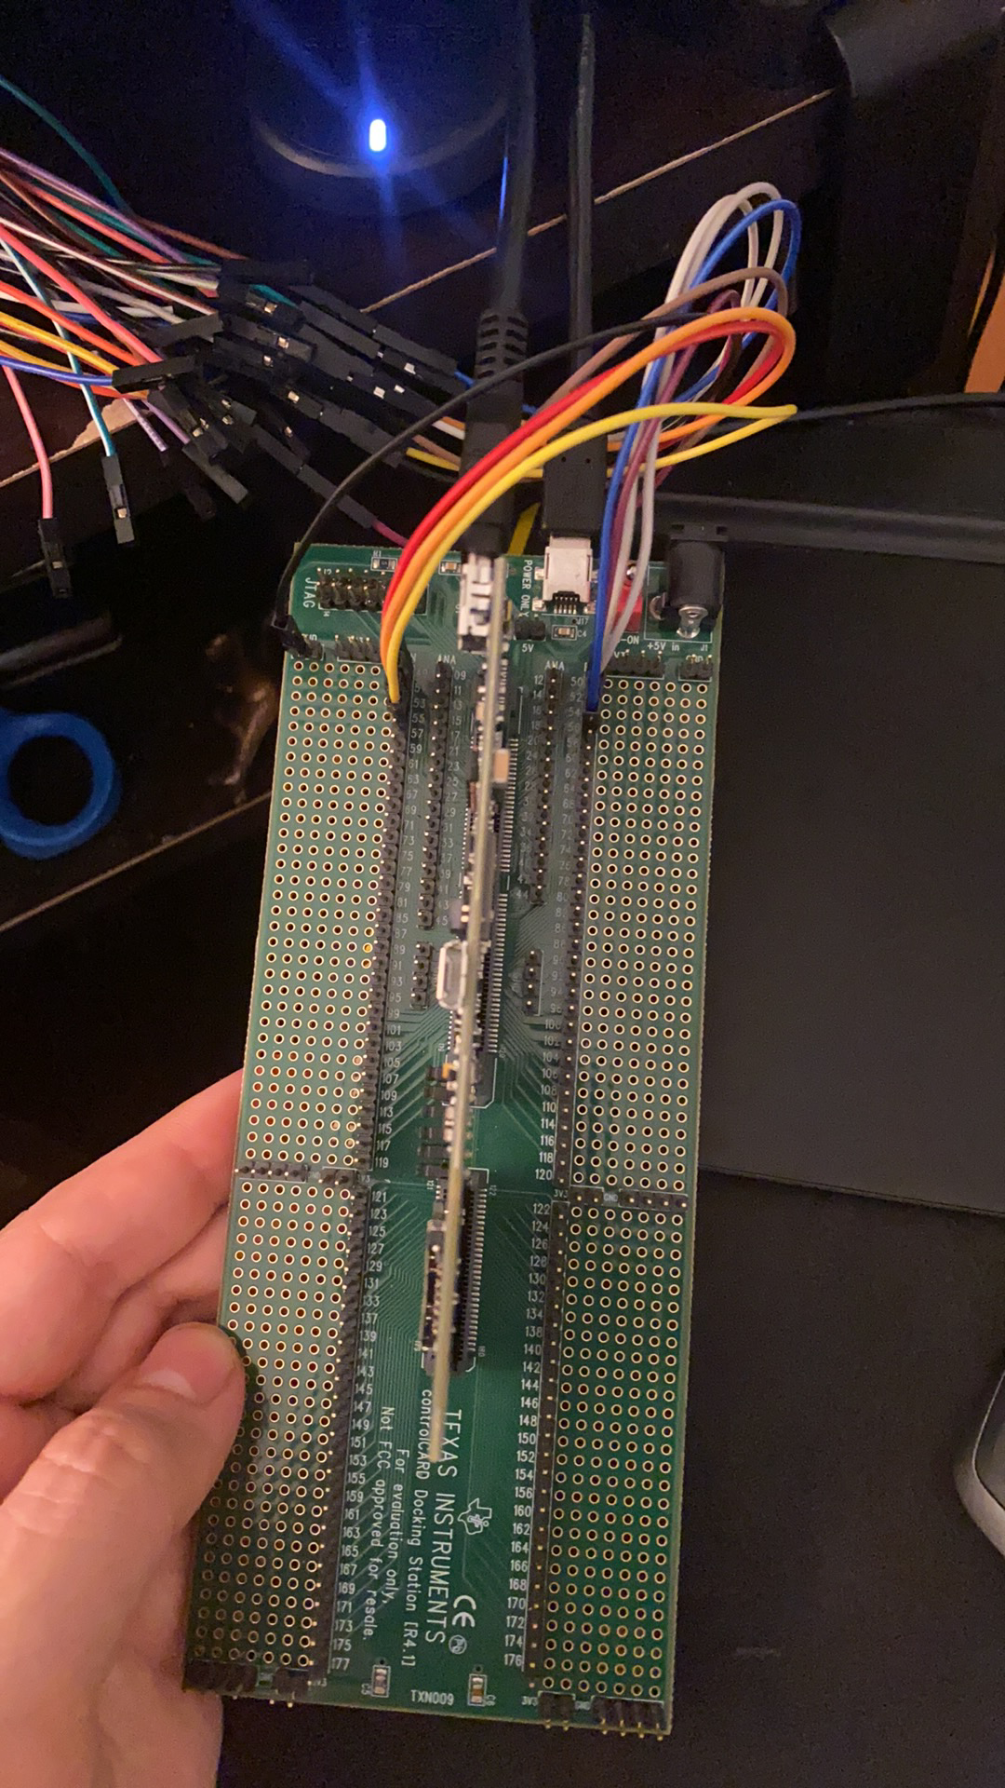
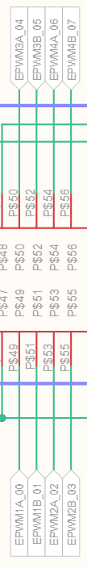
A. Digital Signal Processor (DSP) Pulse Width Modulated (PWM) Signals
[1]
Notes:
[J] :
_

Slide 17
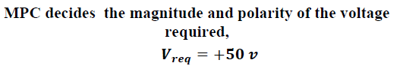
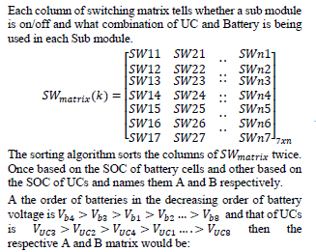
B. State of Charge (SOC) Adapted Sorting Algorithm (Pt. 1)
[1]
Notes:
[J] :
_

Slide 18
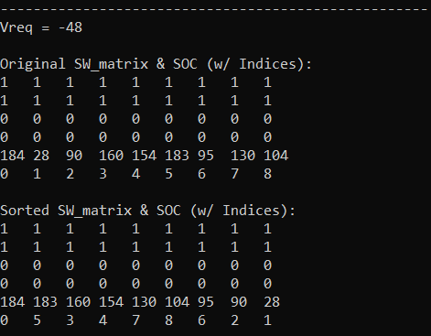
B. State of Charge (SOC) Adapted Sorting Algorithm (Pt. 1)
[1]
Notes:
[J] :
_

Slide 19
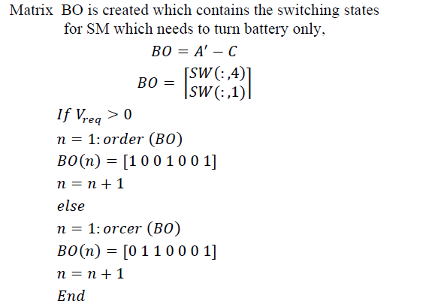
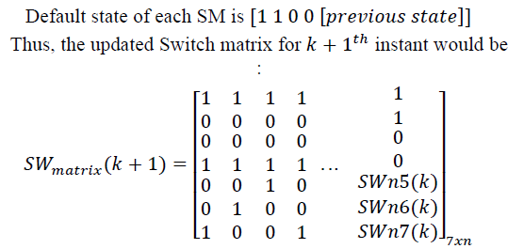
B. State of Charge (SOC) Adapted Sorting Algorithm (Pt. 2)
[1]
Notes:
[J] :
_

Slide 20
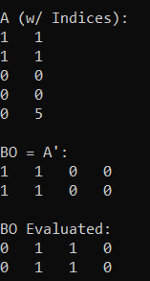
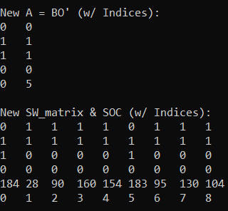
B. State of Charge (SOC) Adapted Sorting Algorithm (Pt. 2)
[1]
Notes:
[J] :
_

Slide 21
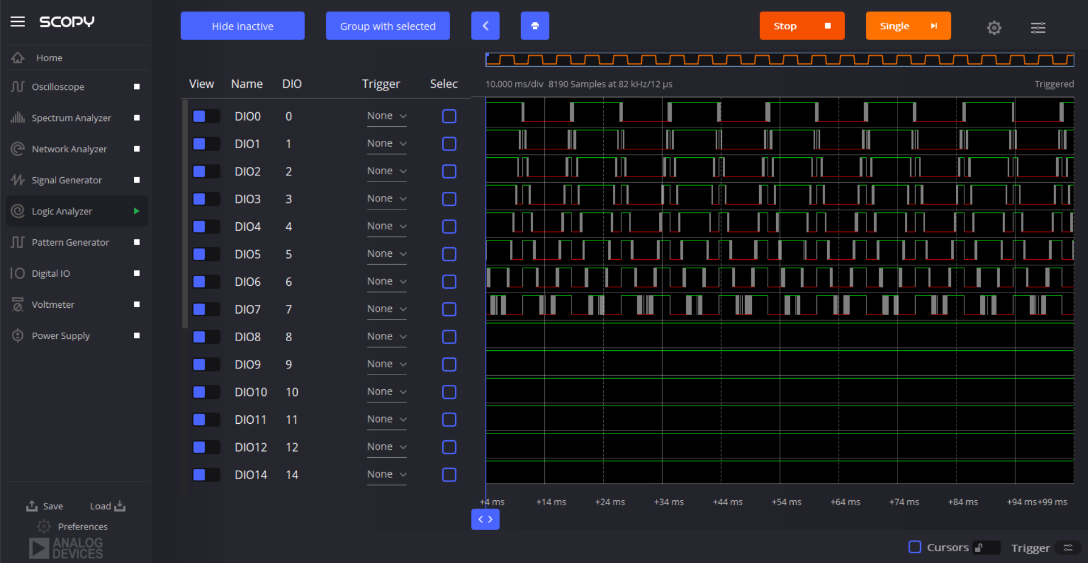
C. PWM Output Results (Pt. 1) w/o any sorting
Notes:
[J] :
_

Slide 22
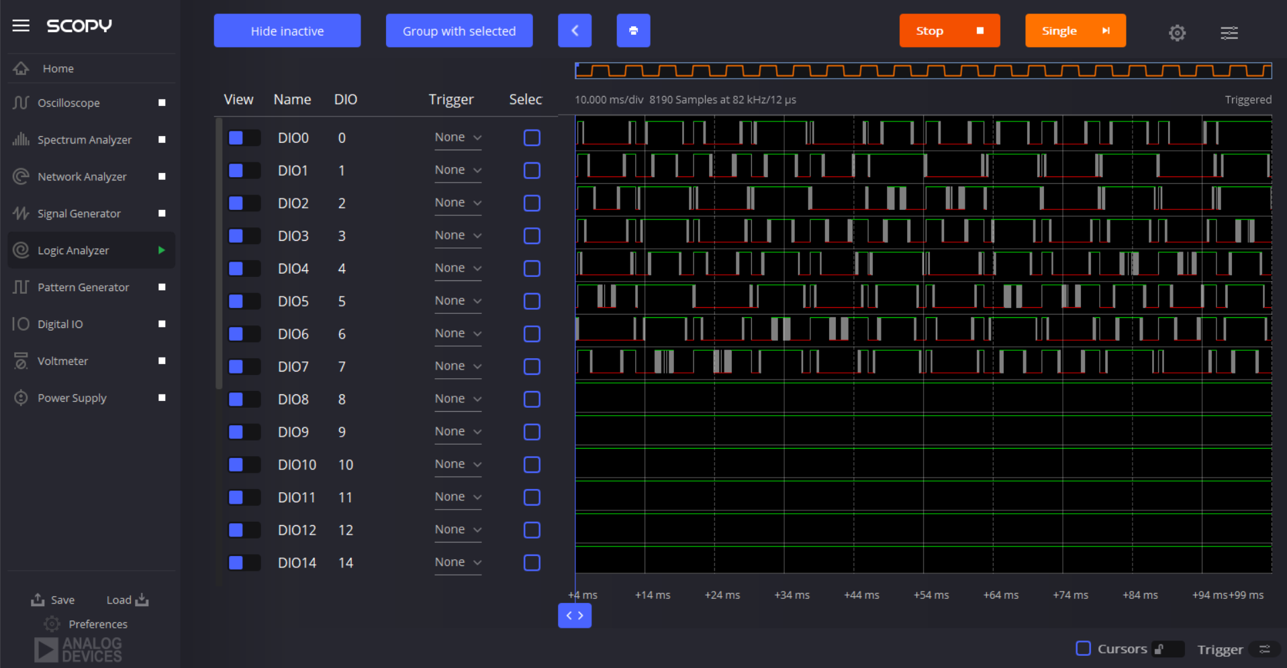
C. PWM Output Results (Pt. 2) SORT_LEVELS
Notes:
[J] :
_

Slide 23
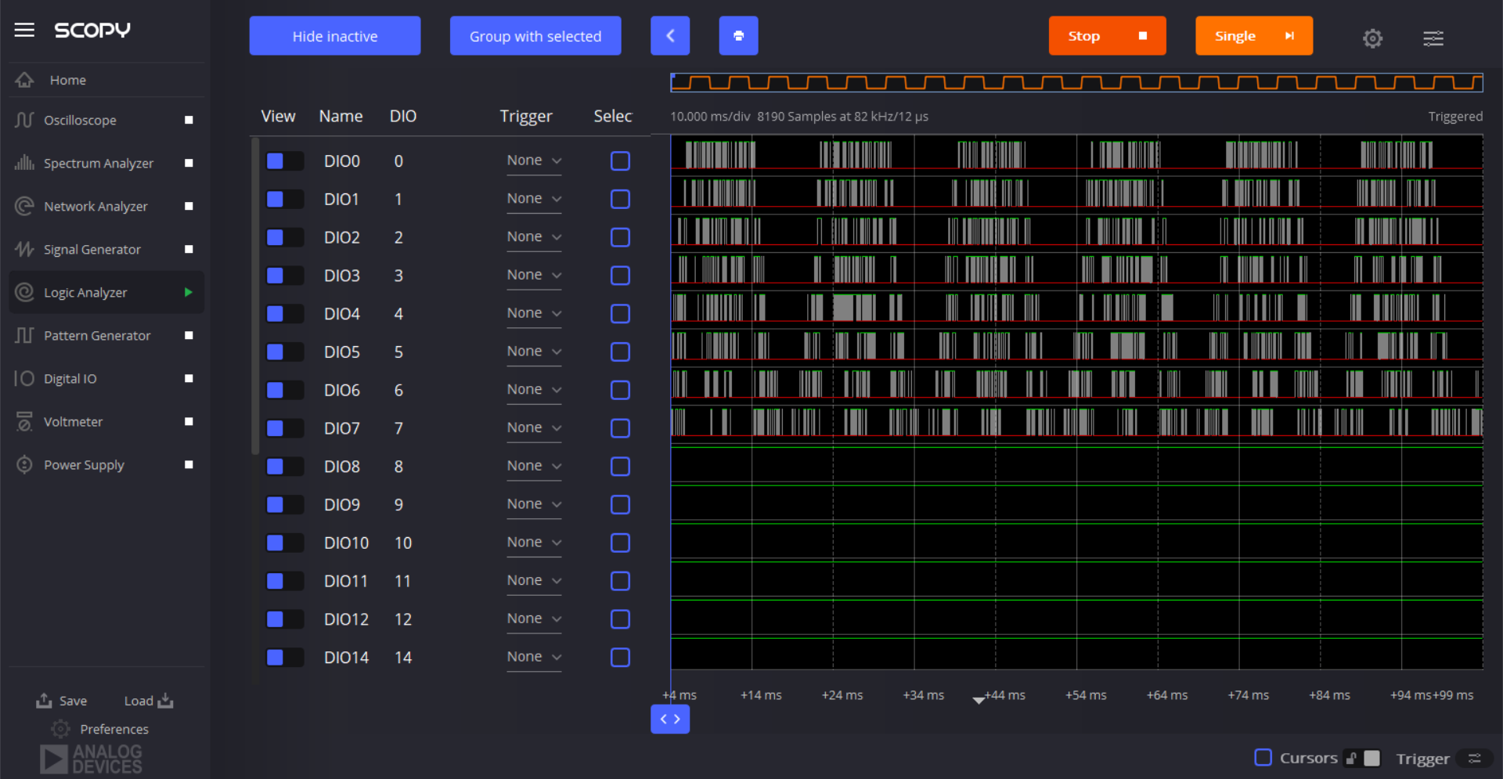
C. PWM Output Results (Pt. 3) SOC_sort_algo
Notes:
[J] :
_

Slide 24
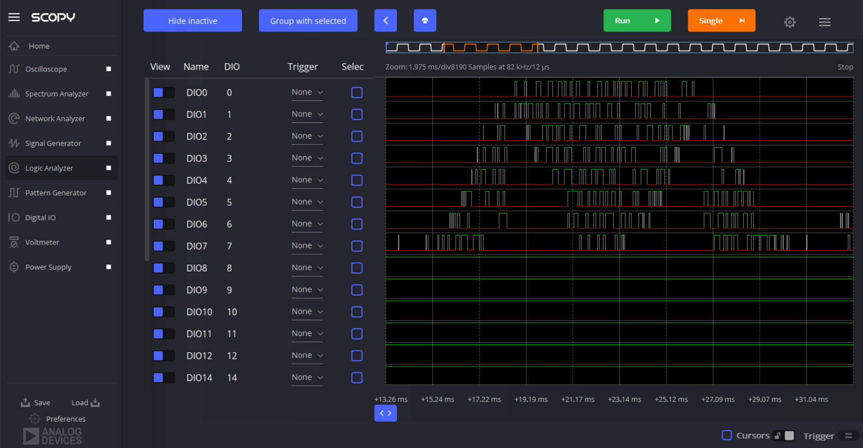
C. PWM Output Results (Pt. 3) SOC_sort_algo
Notes:
[J] :
_

Slide 25
Work Schedule
Team | Member | Task | June |  |  |  |  | July
 |  |  | 6/2 | 6/9 | 6/16 | 6/23 | 6/30 | 7/5 | 7/12 | 7/19 | 7/26
Embedded Systems (ES) | Jonathan | Finish Implementing and Testing SOC Sorting Algorithm
 |  | Write SOC Estimation Algorithm
Power Module Design (PMD) | Andrew | Learn Ansys
 | Hiromi | Redesign VIAs and footprints for Current Sense
 | Andrew & Hiromi | Learn more about designing PCBs on OrCad
 |  | Finish Current Sense PCB Board
Notes:
[J] : ES (12.5mins)
[A/H] : PMD
_

Slide 26
References
[1] S. S. George and M. O. Badawy, A Modular Multi-Level Converter for Energy Management of Hybrid Storage System in Electric Vehicles, 2018 IEEE Transportation Electrification Conference and Expo (ITEC), Long Beach, CA, USA, 2018, pp. 336-341, doi: 10.1109/ITEC.2018.8450237. Available at: <https://ieeexplore.ieee.org/abstract/document/8450237> [Accessed 8 May 2021].
[2] T. Randall, "Here’s How Electric Cars Will Cause the Next Oil Crisis", Bloomberg.com, 2016. [Online]. Available: <https://www.bloomberg.com/features/2016-ev-oil-crisis/> [Accessed: 08 May 2021].
Notes:
[J] :
_

Slide 27

Questions
Notes:
[J] :
_

